Slide 1


Tuesday, September 22, 2020
MEMBERSHIP MEETING
PLEASE SUBMIT ALL QUESTIONS THROUGH THE CHAT FUNCTION

Slide 2

September 22, 2020
Agenda
Welcome
Secretary
Treasurer
Membership
Welcoming Committee
Security Update
Alcoa Hwy
Beautification
Social
Communications
Nominations
Greenway
New Business
PLEASE SUBMIT ALL QUESTIONS THROUGH THE CHAT FUNCTION

Slide 3
SECRETARY
Suzan Bowman
Approval of Minutes from January 2020
PLEASE SUBMIT ALL QUESTIONS THROUGH THE CHAT FUNCTION
Notes:
All minutes are posted on our website www.lakemoor.org

Slide 4
FINANCIAL
Jim Kincaid, Treasurer
  Beginning Balance - $16,689
  Income - $8,263
  Expenses - $1,027
  Ending Balance - $23,925
PLEASE SUBMIT ALL QUESTIONS THROUGH THE CHAT FUNCTION
Notes:
For questions contact Jim Kincaid at jbkincaid@att.net or ‭(865) 250-2828‬.

Slide 5
2020-21 MEMBERSHIP
Over 200 households have renewed
Committee Volunteers
  Beautification (18)
  Welcoming (2)
  Alcoa Hwy (11)
  Security & ERT (7)
  Communications (5)
  Social (11)
  Greenway (18)
PLEASE SUBMIT ALL QUESTIONS THROUGH THE CHAT FUNCTION
Notes:
If you have not yet renewed your membership please visit www.lakemoor.org and select Membership & Dues Renewal. The dues are $40 per year. One of the benefits of membership is a 50% discount for waste removal through Waste Connections.

Slide 6
WELCOME
Welcoming all new residents to the neighborhood
Cindy Conner Coughlin, Chair
New Residents
  Sara Price – 4040 Maloney
  Lyle & Sabrina Conklin – 2504 Mont Glen
  Kevin Proffitt – 2117 Manor
  Jorden Lee Rockwell – 3121 Monlake
  Thomas Turner – 3133 Gazebo Point Way
  John & Lisa Black – 2305 Carriage
  3829 Maloney Rd.
  Mark Priestley - 3520 Timberlake
  3613 Timberlake
  3528 Maloney
PLEASE SUBMIT ALL QUESTIONS THROUGH THE CHAT FUNCTION
Notes:
The Welcoming Committee visits each new resident to Lakemoor Hills and takes them a welcome packet of information about our organization, our neighborhood and security preparation bags. The committee depends upon all of us letting them know when a new family moves in. Please contact Cindy Conner Coughlin at cconnorcoughlin@gmail.com or ‭(865) 414-8683 if you would like to be part of this welcoming group or know of someone who have moved to Lakemoor Hills.

Slide 7
EMERGENCY RESPONSE TEAM (ERT) Providing assistance to our neighbors in times of need
Review of Purpose
In Case of Emergency - Dial 911
PLEASE SUBMIT ALL QUESTIONS THROUGH THE CHAT FUNCTION
Notes:
Bob Proctor, chair – 865-742-9035 or proctorhodge@gmail.com
The ERT is comprised of your neighbors who have volunteered to cover 20 areas in our neighborhood. The ERT members are ready to respond to immediate needs in the aftermath of an emergency event. When emergency services like police, fire, first responders or EMS are not readily available, due to priority being given to other areas, the ERT may be able to help. Each family should prepare a ready kit to provide for your family for up to 3 days. The list of items that you could include is printed on your Ready Kit bag. (provided by the Welcoming Committee to each new resident) Please contact a member of the ERT if you have questions.
In case of emergency, you should first dial 911.

Slide 8
SECURITY
CAMERA
LOCATIONS
PLEASE SUBMIT ALL QUESTIONS THROUGH THE CHAT FUNCTION
Notes:
The 3 new camera systems approved by the HOA in January are in place, operable and reporting directly to the KPD and Knox Co. Sheriff’s office. The locations are depicted in the graphic. These cameras record license tags of vehicles passing the 3 locations. If you have an incident, dial 911 to report. Describe the incident and inform the authorities of the camera system. The police can search by time of incident and partial license plate, so be specific about capturing that information. Also follow up with your area captain to make them aware of the incident.

Slide 9
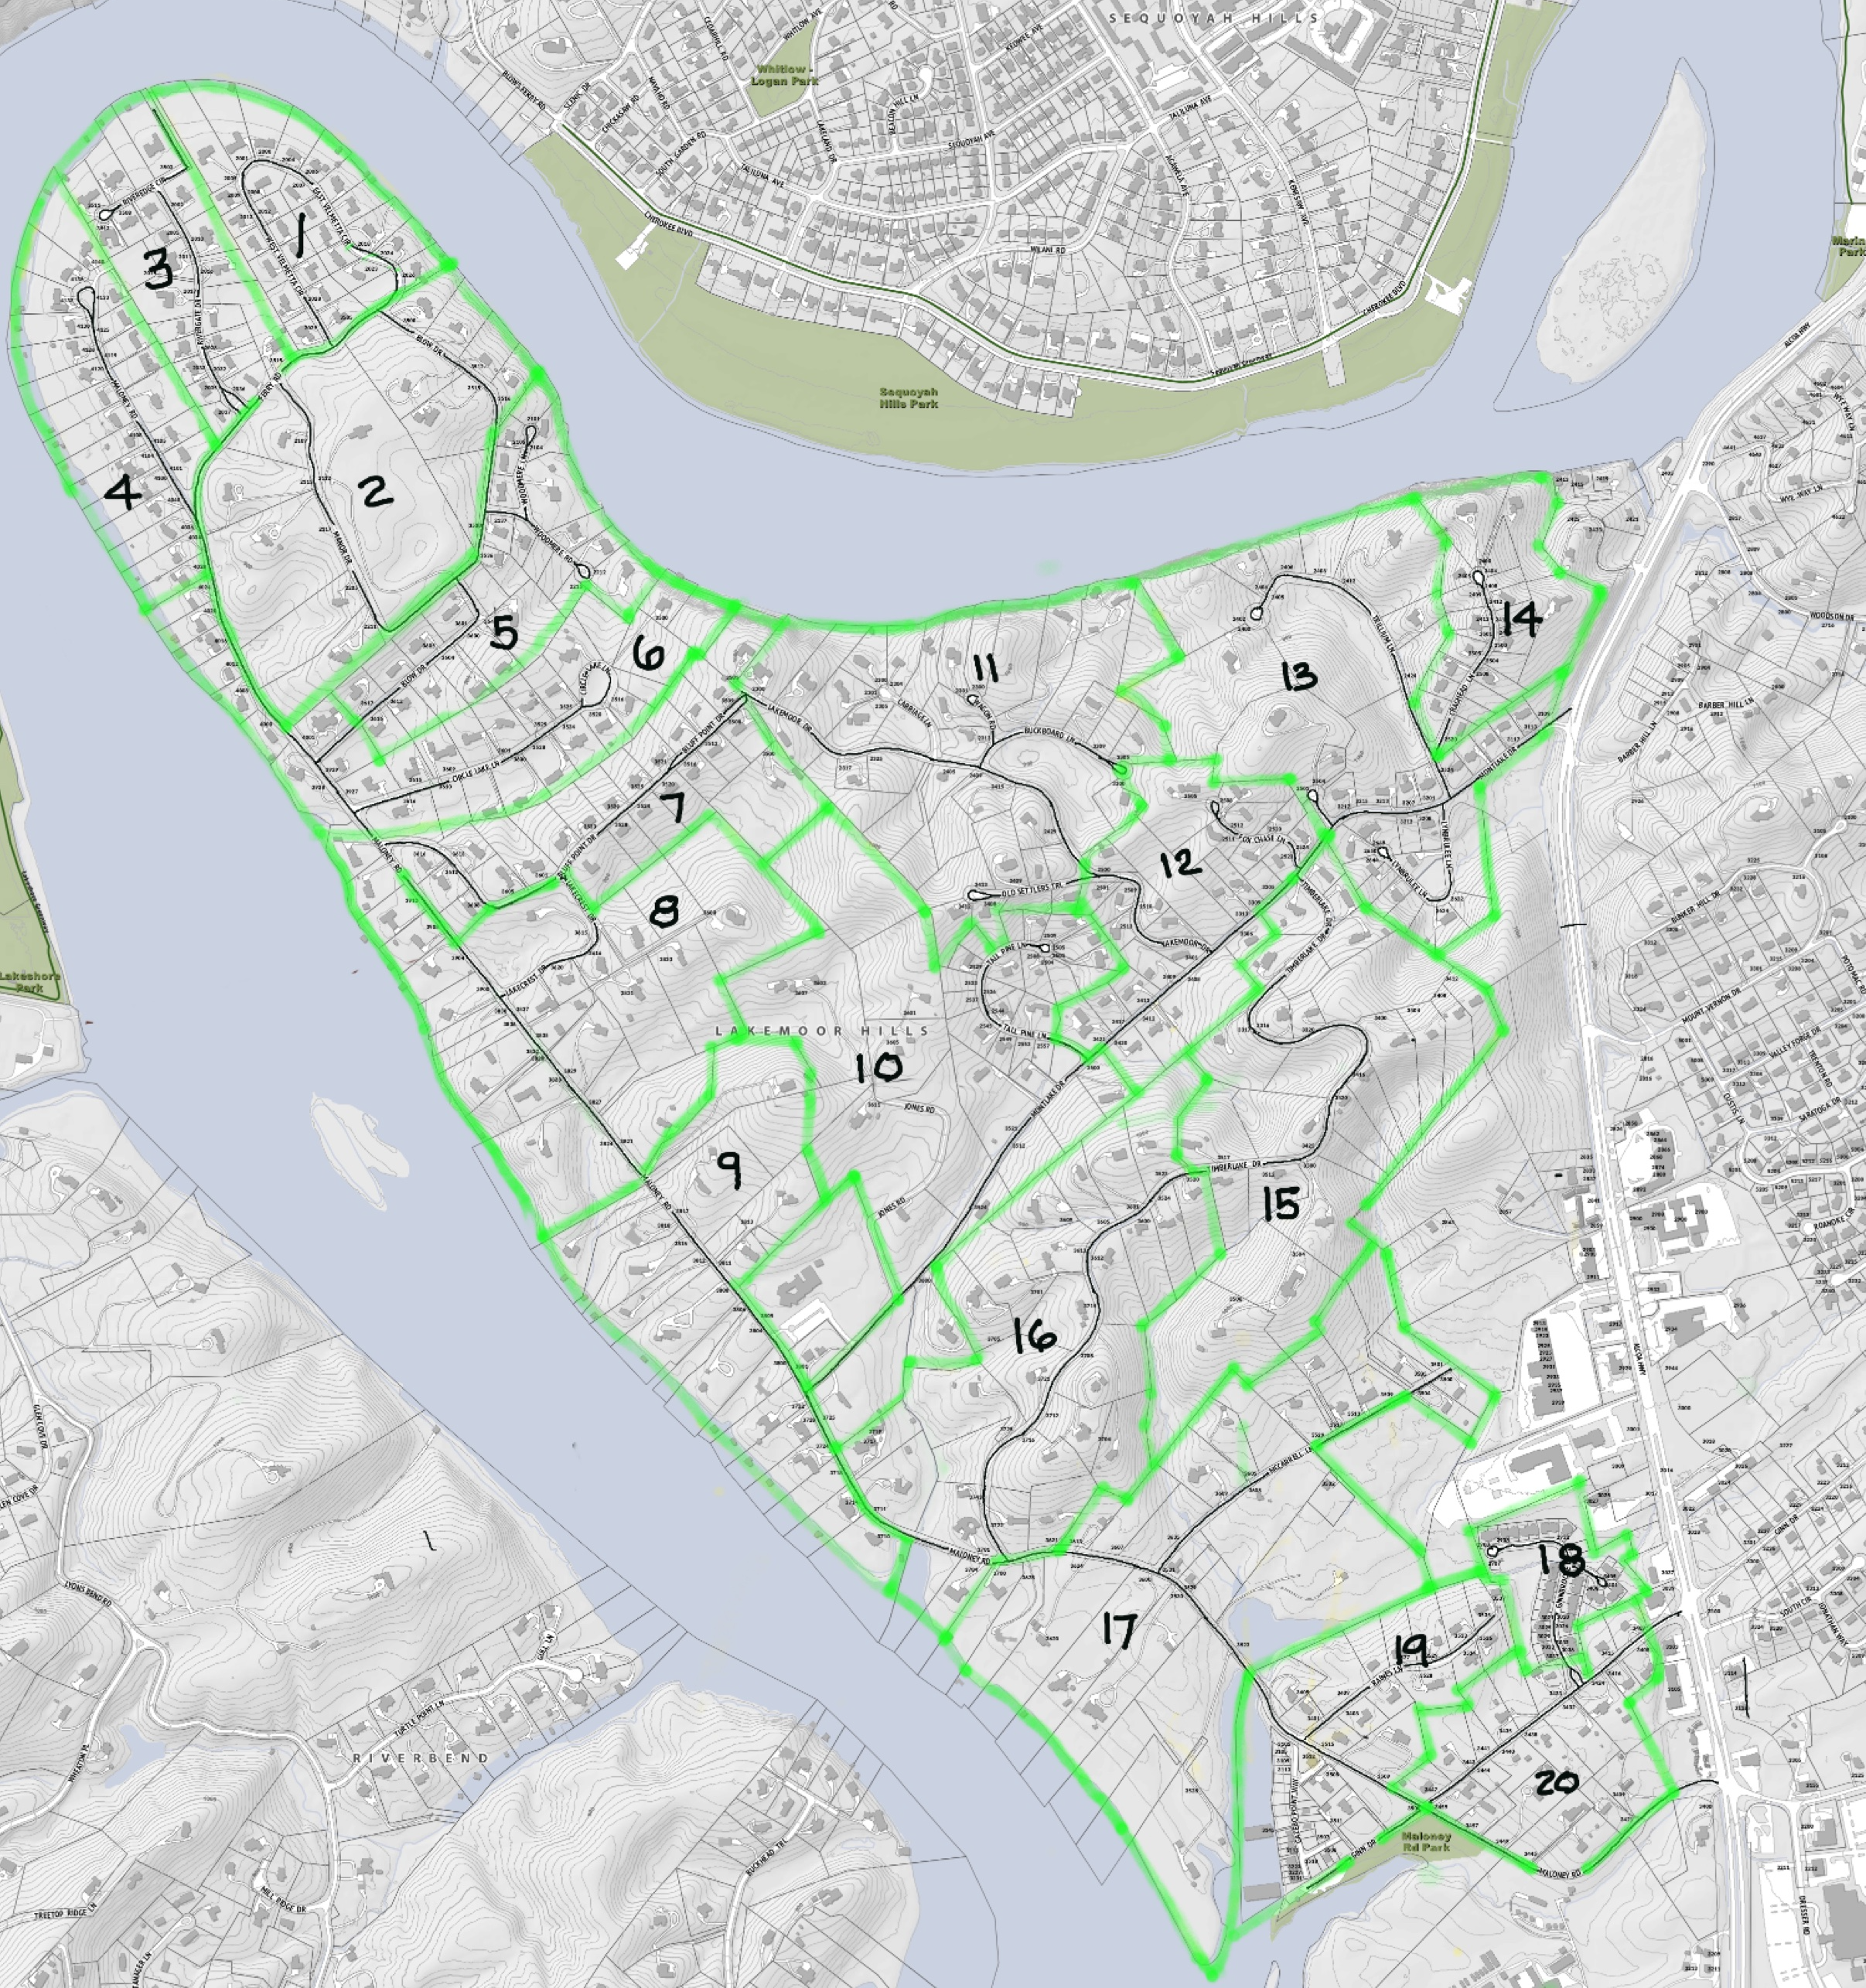
AREA SECTORS
& AREA CAPTAINS
PLEASE SUBMIT ALL QUESTIONS THROUGH THE CHAT FUNCTION
Notes:
The neighborhood is divided into 20 area sectors with an ERT area captain assigned to each sector. That person will be your contact for assistance or reporting. This map and the list of area captains can be found on the Lakemoor Hils website and on the Lakemoor Hills Facebook page. Use this map to determine in which sector you reside.

Slide 10
NOTIFICATION NETWORKS Communication during emergencies
KEMA Signup link: http://knoxtnlepc.org
Area Captains
Text Alert
PLEASE SUBMIT ALL QUESTIONS THROUGH THE CHAT FUNCTION
Notes:
The neighborhood has several communication systems to help notify residents of relevant emergency information. The Knoxville Knox County Emergency Management Agency notification system is available for anyone to subscribe and managed out of the KEMA office. Through this system you will hear about all emergencies in Knox County. Use the link above to subscribe. Getting word to your Area Captains allows them to notify other affected sectors. The text alert system is described on the next slide.

Slide 11

TEXT ALERT
Primary Contact – Forrest Orr
Criteria for rising to ALERT STATUS
  Criminal activity
  Roads Blocked
  Weather Emergencies
Text DETAILS to 55678 to subscribe
Notes:
The Text Alert System is a closed system that allows the security team to send you text messages to inform you of any critical information about incidents in our neighborhood. To subscribe, text DETAILS to 55678. To report an issue that should be communicated to the neighborhood, please contact Forrest Orr at ‭(865) 679-1970 or orr.forrest@gmail.com

Slide 12
ALCOA HWY UPDATE
Alcoa Hwy Beautification Council
Landscape Plans
  Posted at www.lakemoor.org
  $60,000 from City
Business Sector Charrette – July 2019
Signage
Schedule
PLEASE SUBMIT ALL QUESTIONS THROUGH THE CHAT FUNCTION
Notes:
Kathy Proctor chairs the Alcoa Hwy Beautification Council that is a group comprised of representatives from our HOA, the garden clubs, Martha Washington Heights. Through this group we have been able to fund the development of Landscape Plans for the enhancement of the new roundabouts at Maloney, Montlake and add trees adjacent to the new bridges. There will also be 2 test areas for wildflowers. In July 2019 the group hosted a Busines Sector Design Charrette to help provide solutions and ideas for the revitalization of the commercial corridor adjacent to our neighborhood. Currently we are working with the City of Knoxville and TDOT to develop a signage package for the commercial district. The landscape is scheduled to be installed at the completion of construction in Fall of 2021. If you have any questions or would like to be part of this effort, please contact Kathy Proctor at 865-599-7783 or KSP53@me.com.

Slide 13
BEAUTIFICATION
Enhancing the beauty of Lakemoor Hills
Randy Kerns, Chair
Upcoming Activities Winter
  Holiday Spirit Award
  Christmas Tree Lighting
  Mailbox Toppers
Spring Activities
  Natural Beauty Award
  Neighborhood Cleanup Day
Doggie Waste Stations
Notes:
The Beautification Committee has a number of activities each year that focus on enhancing the beauty of our wonderful neighborhood. Each winter season as neighbors decorate their homes for the holidays, the Holiday Spirit Awards are announced – recognizing outstanding Holiday Decoration efforts. Early in December the neighborhood gathers together to decorate the fir tree on the Maloney side of Lake Hills Presbyterian Church, gather around the bondfire, sing Christmas carols and enjoy some holiday treats. The Garden Club will offer holiday mailbox toppers and swags for purchase. In the spring we host many visitors to our Dogwood trails. In preparation for that we hold a Neighborhood Cleanup Day in March to spruce up the area, the Garden Club offers mailbox bows, and the Natural Beauty Awards are selected for outstanding spring foliage. This committee also manages the Doggie waste stations that are located at Lakemoor Legacy Park & Garden, Bluff Point median and the church walking trail. If you would like to be apart of this group, please contact Randy Kerns at (937) 694-5627 or randykerns@panyard.com.

Slide 14
SOCIAL COMMITTEE
Providing ways to network with your neighbors
Suzan Bowman, Chair
  Neighborhood Picnic – May
  Neighborhood Happy Hours
    3rd Friday
Notes:
This year has been challenging for us to come together as a group. We had to cancel our Neighborhood Picnic in May, and the Trunk or Treat in October, but we do have Happy Hours occurring each 3rd Friday at Lakemoor Legacy Park and Garden at Circle Lake. Come bring a beverage, a snack, a lawn chair and visit while social distancing. And we will see you at the picnic next May. To join this committee contact Suzan through ‭(865) 705-9451 or suzanbowman@gmail.com

Slide 15
COMMUNICATIONS
Supporting an online community that seeks to elevate and enhance our neighborhood and encourage fellowship, neighborhood connections, respectful dialog and keeping our neighborhood informed.
Dawn Thomas, Chair
Communication Networks
  www.lakemoor.org
  FACEBOOK
    Lakemoor Hills HOA
Social Media Policy
PLEASE SUBMIT ALL QUESTIONS THROUGH THE CHAT FUNCTION
Notes:
Communications Committee Update
Purpose
Committee supports an online community and seeks to elevate and enhance our neighborhood and encourage fellowship, neighborhood connections, respectful dialog and keeping our neighborhood informed.
We have two communications channels for the neighborhood.
Website: www.lakemoor.org
The web site is used for representing the Homeowners Association and to share related information with visitors.
Facebook: https://www.facebook.com/groups/lakemoorhillshoa
Each person who lives on the Lakemoor Hills peninsula may request access to the LHHA Facebook page. Membership in the LHHA is not required.
Updates
A new Social Media Policy has been created that provides a reference guide for all residents on our social media platforms. It will be posted on the Website and Facebook soon.
We welcome you to join the Communications Committee. We’re connected not by a shared preference, but a shared connection to a place — our neighborhood. If you enjoy communications and connecting with your neighborhood, please just us and let’s build a strong online community together.
For More Information
For questions, comments or to get involved, please contact the Communications Committee Chair, Dawn Thomas at 865-384-9542 or damaccammon@comcast.net

Slide 16
NOMINATIONS
Kathy Proctor, Chair
Current Year
  All remain in place
  Opening for Vice -President
PLEASE SUBMIT ALL QUESTIONS THROUGH THE CHAT FUNCTION
Notes:
As Past President Kathy Proctor chairs the Nominating Committee. This year since we have had to postpone so many activities due to COVID, the entire board and committee chairs agreed to serve one more year. But we do have one current opening for Vice President, and will have board members rolling off the board in the next year. If you have interest in leadership in our organization – serving as a leader or helping seek new leadership – please contact Kathy Proctor at ksp53@me.com or 865-599-7783.

Slide 17

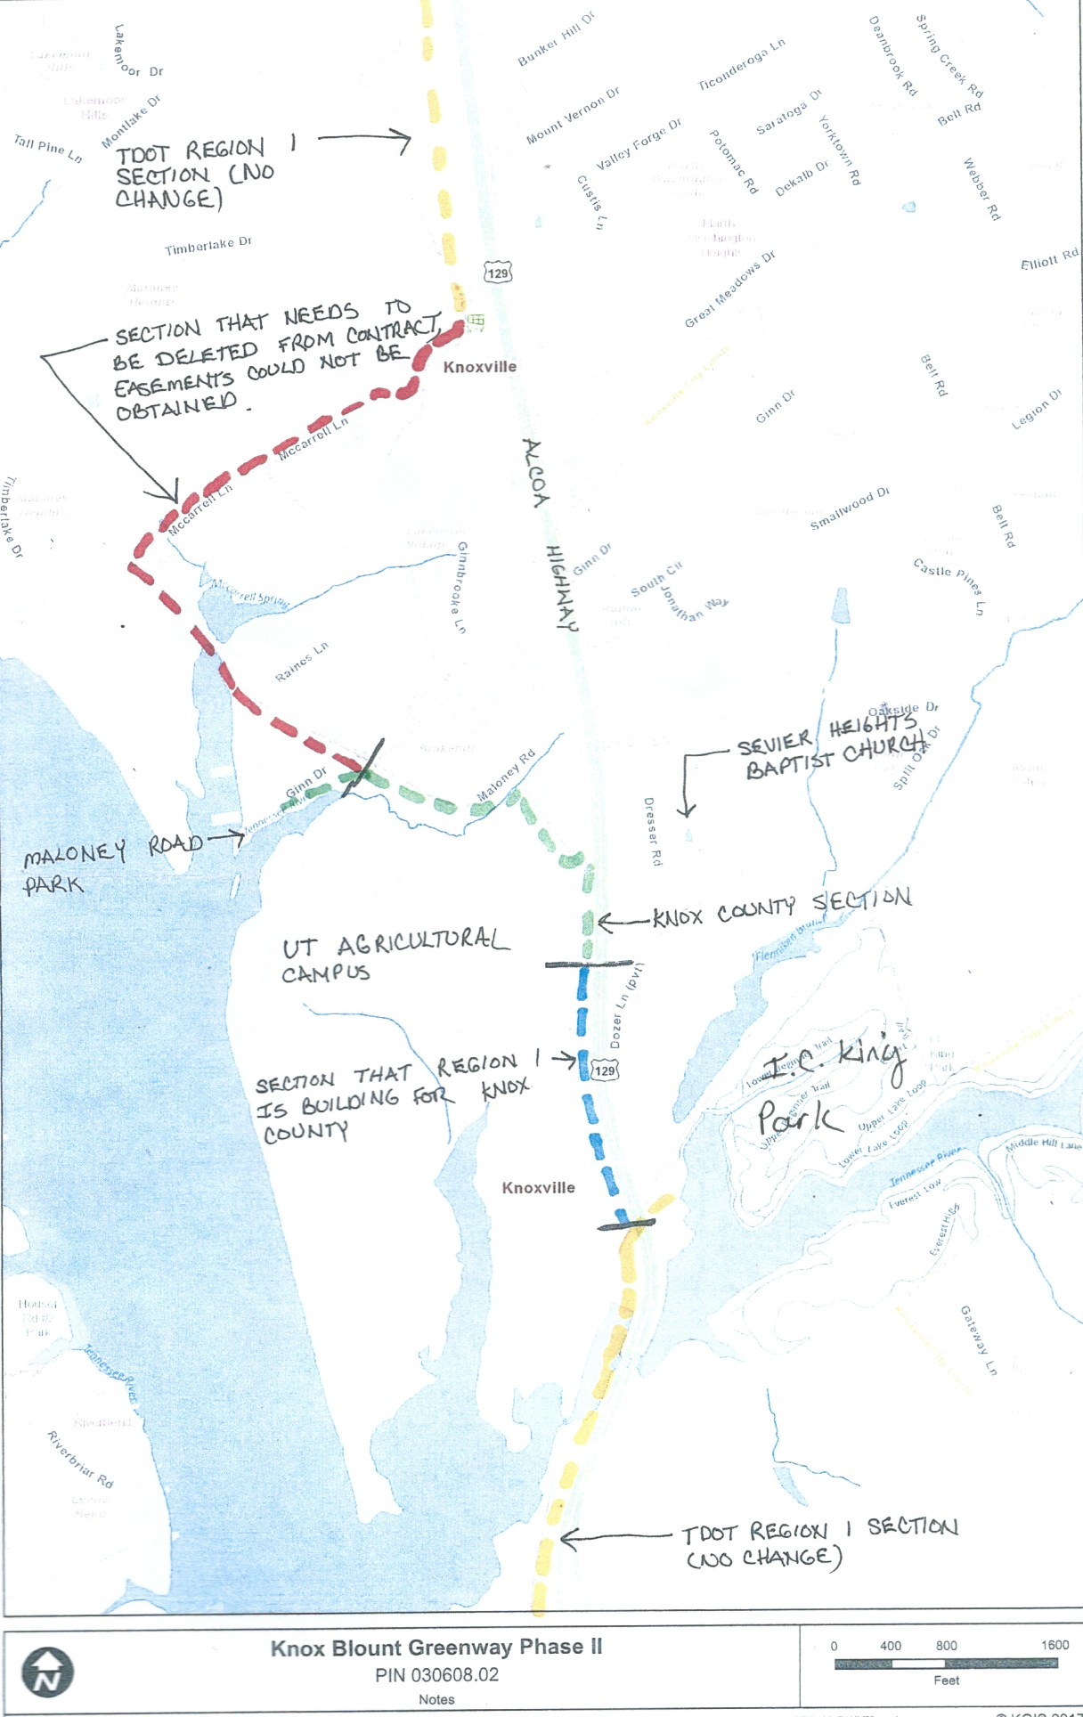
GREENWAY
The Missing Link
Notes:
The Knox County – Blount County Greenway is planned to connect Knoxville to the Smokies. The Knoxville portions of the plan are depicted in this hard to read drawing. Starting from the top (in yellow) is the portion of the greenway that is being constructed as part of the Alcoa Hwy expansion that should connect behind the Marine base culminating at CVS. Most of that will be completed in Fall of 2021. The green section is under construction now connecting Maloney Road Park to ICK park across the UT farms. The portion in RED is the Missing Link. The time is right for us to organize and put pressure on decision-makers in our city and county governments to fund this section and get this piece started. There were 18 people who said in their membership renewals that they would like to be part of making this happen. I’ll be calling a meeting shortly to organize this effort. If you understand how beneficial a greenway would be to our neighborhood and would like to be a part of this group, please email Kathy Proctor at ksp53@me.com.

Slide 18
UPCOMING EVENTS
Lakemoor Legacy Park & Garden
at Circle Lake
OCT 23 – 5 PM Happy Hour
OCT 23 – 4 – 7 PM
Garden Club Plant Sale
OCT 24 – 10 AM – Noon
Garden Club Plant Sale
PLEASE SUBMIT ALL QUESTIONS THROUGH THE CHAT FUNCTION
Notes:
Join us at Lakemoor Legacy Park & Garden located at Circle Lake on October 23 for our neighborhood Happy Hour. Bring a beverage and a snack to share. You can also participate in a plant sale organized by the Lakemoor Hills Garden Club that will serve as a fundraiser to support the garden. The plant sale will continue to the morning of October 24. Bring a friend.

Slide 19
“A Taste of Lakemoor Hills” Cookbook
We want your favorite recipes to create a “Taste of Lakemoor Hills” Cookbook!
Funds will benefit neighborhood improvement projects through the Lakemoor Hills Resource Council.
Share your recipes, stories, history of the peninsula!
Look for more information on how to submit your recipes and stories via Lakemoor.org and the neighborhood Facebook page.
We will have online forms as well as printed forms for your convenience.
Deadline for submissions will be October 31.
PLEASE SUBMIT ALL QUESTIONS THROUGH THE CHAT FUNCTION
Notes:
The Lakemoor Hills Resource Council is organizing the “A Taste of Lakemoor Hills” cookbook project. The book will be filled with tidbits of history about the neighborhood, pictures, and tasty recipes from your neighbors. Proceeds from the cookbook sale will go towards funding additional improvement projects within the neighborhood. Laura Ward and Susannah Perry are the committee chairs. You will see signup info on our Facebook page and the LHHA website or you can pick up a hard copy of the form at Susannah Perry’s home at 2205 Manor Dr. from a real estate box.

Slide 20
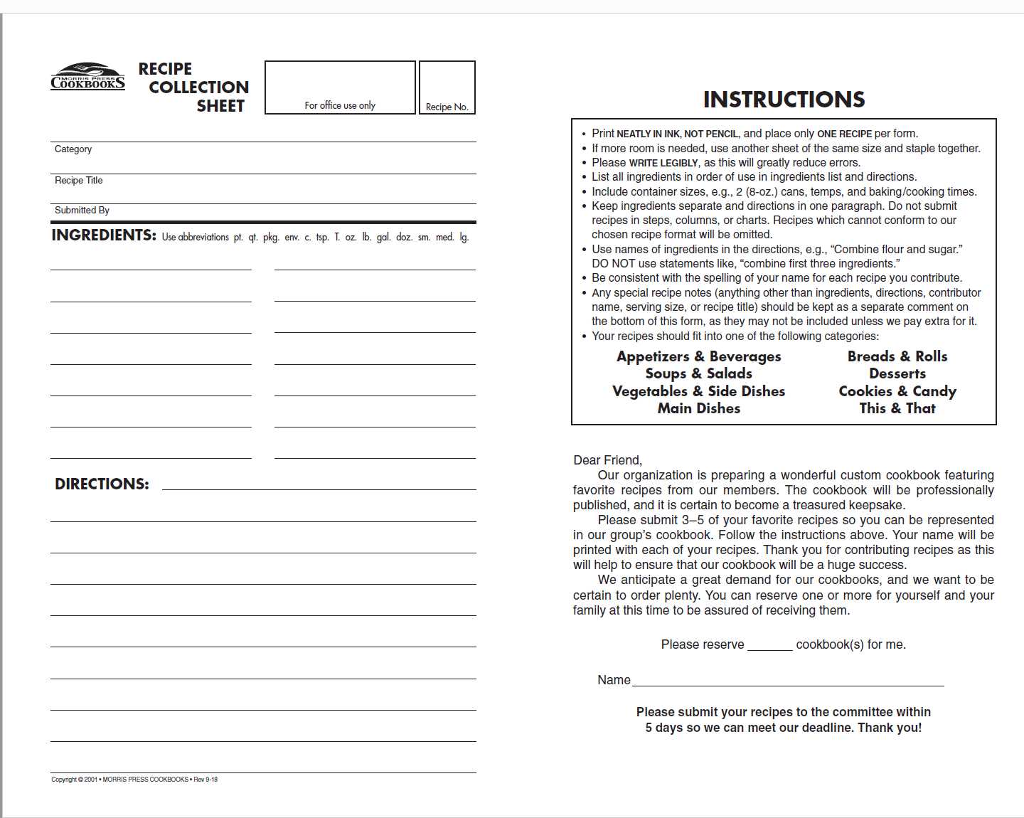

Slide 21

NEXT MEETING
NOVEMBER 17, 2020
PLEASE SUBMIT ALL QUESTIONS THROUGH THE CHAT FUNCTION

